Slide 1
Fire Pump Controllers 101
SGM Engineering

Slide 2
Fire Pump Controllers 101
Outline
Codes and Standards
Listing and Approval Agencies
General (electric motor & diesel engine driven fire pump controllers)
Electric Fire Pump Controllers (electric motor driven)
Diesel Fire Pump Controllers (diesel engine driven)
Jockey Pump Controllers

Slide 3

Fire Pump Controllers 101
Codes & Standards
NFPA – National Fire Protection Association
NFPA 20 – Standard for the Installation of Stationary Pumps for Fire Protection
  Latest Edition 2019
Chapters pertinent to fire pump controllers
    Chapter 10 – Electric
    Chapter 12 - Diesel

Slide 4

Fire Pump Controllers 101
Codes & Standards
NEC – National Electrical Code
Section 695 – Fire Pumps
Pertinent to electrical installation requirements
Latest Editions 2014
Same as NFPA70

Slide 5

Fire Pump Controllers 101
Listing & Approval
UL – Underwriters Laboratory
Headquarters in Northbrook, IL
Scope of business is the protection of life and property
Issues “Listings” in regards to equipment built to the NFPA20 standard

Slide 6

Fire Pump Controllers 101
Listing & Approval
FM Global (aka Factory Mutual)
Headquarters in Boston, MA
Scope of business is the protection of life and property
Issues “Approvals” in regards to equipment built to the NFPA20 standard

Slide 7
Fire Pump Controllers 101
General
A fire pump controller serves to protect life and property and not the equipment it controls
Devices serving to protect a motor, engine or pump are not allowed per NFPA20, UL and FM
  Ex: overload, low oil pressure, high temperature, low suction pressure

Slide 8
Fire Pump Controllers 101
General
However, NFPA20, UL and FM do allow the controller to stop the pump under these conditions only:
  Electric Fire Pump Controller
    Locked rotor
  Diesel Fire Pump Controller
    Overspeed

Slide 9
Fire Pump Controllers 101
General
Location
  Controller shall be located within sight of the fire pump and vice versa
  Controller shall be installed so that all load carrying components are 12” above floor
  Controller shall not be used as a junction box
    Jockey pump shall not be powered by the fire pump controller

Slide 10
Fire Pump Controllers 101
General
Enclosure NEMA type rating
  Minimum rating as per NFPA20 is type 2
      Drip-proof (water falling from above)

Slide 11
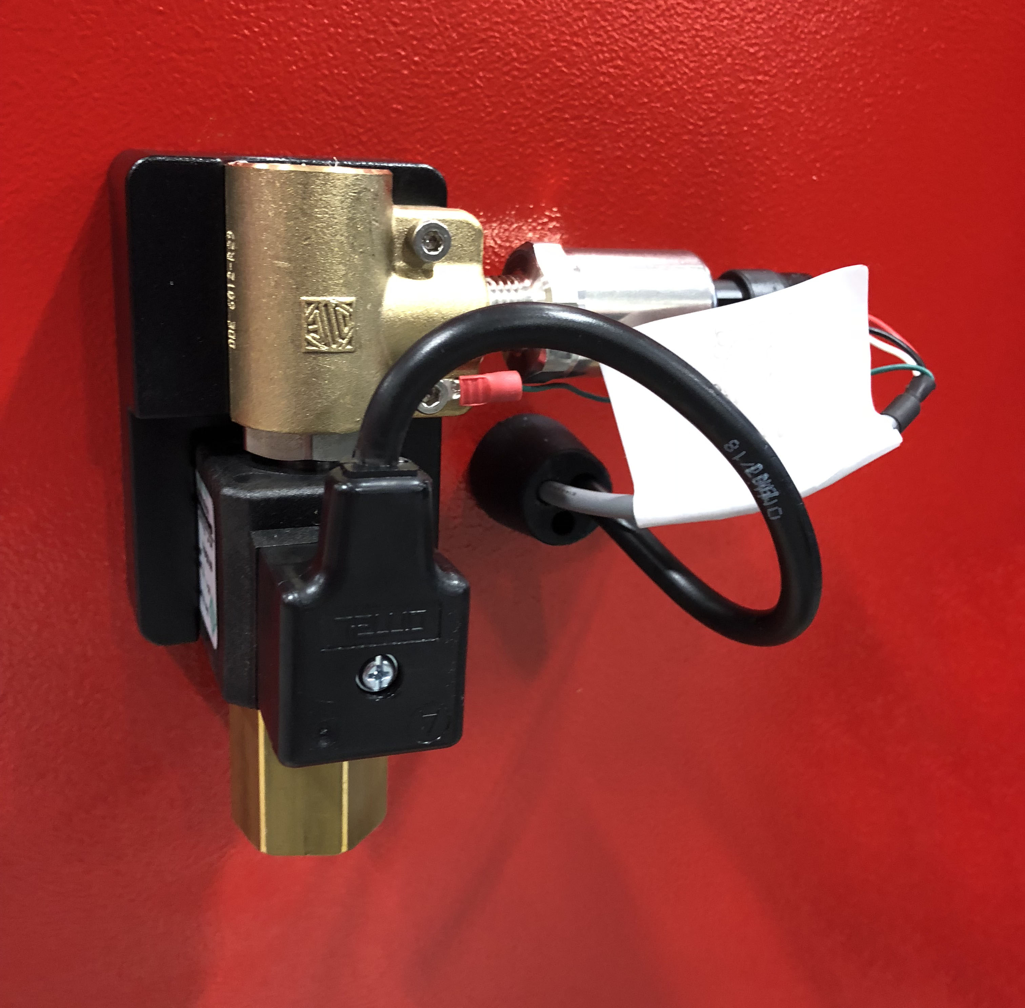
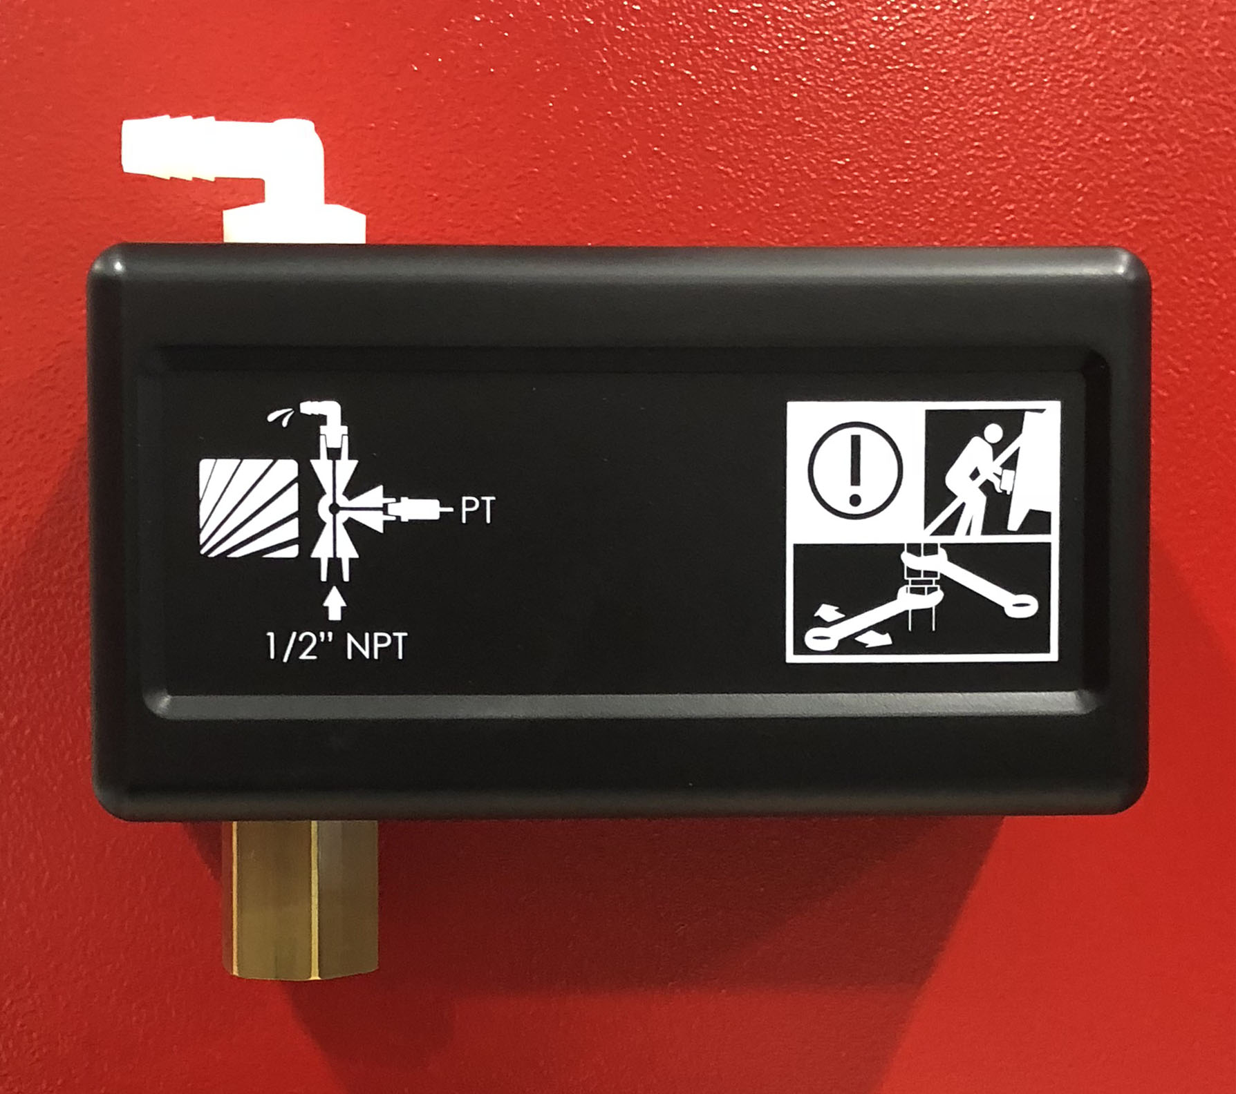
Fire Pump Controllers 101
General
Pressure sensing assembly
  Pressure transducer
  Test solenoid valve
  1/2 inch connection for sensing line
  3/8 inch drain connection

Slide 12
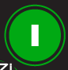
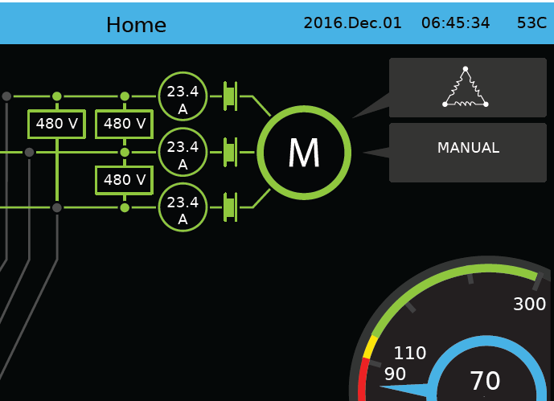
Fire Pump Controllers 101
General
Allowable Starting Modes
  Manual start (START pushbutton)
  Automatic start (pressure drop)
  Manual or automatic external device
    Remote start station
    Deluge valve
    Emergency start

Slide 13
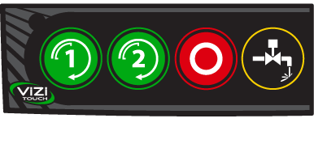
Fire Pump Controllers 101
General
Allowable Stopping Modes
  Manual stop (STOP pushbutton)
  Automatic stop/shutdown (After the expiration of a minimum run timer if starting cause is no longer present
    Note: Automatic stop/shutdown must be approved by AHJ

Slide 14
Fire Pump Controllers 101
General
Allowable Testing Modes (start and stop)
  Manual “Run Test”
      Will start upon activation of the “Run Test” pushbutton and stop after the expiration of the test duration timer
  Programmed “Periodic Test”
      Will start at a pre-determined adjustable time and date upon activation of the test solenoid valve and stop after the expiration of the test duration timer

Slide 15
Fire Pump Controllers 101
Electric Fire Pump Controllers
Types
  Full Service
  Limited Service
  Other types*
      Variable Speed
      Medium Voltage
      Residential
*Note: Other types are not supplied with a ViZiTouch V2 Operator Interface.

Slide 16
Fire Pump Controllers 101
Electric Fire Pump Controllers
Full Service
  UL Listed / FM Approved
  3 phase power only (single phase not allowed)
  No limitation of horsepower (5hp and up)
*Note: Other types are not supplied with a ViZiTouch Operator Interface.

Slide 17
Fire Pump Controllers
Starting Methods Summary
 | ACROSS- THE-LINE | PART WINDING | AUTO TRANSFORMER | SOFT START SOFT STOP | PRIMARY RESISTOR | WYE-DELTA CLOSED TRANSITION | WYE-DELTA OPEN TRANSITION
MODEL NUMBER | GPA | GPP | GPR | GPS | GPV | GPW | GPY ⁽⁵⁾
STARTING VOLTAGE PER WINDING | FULL | FULL | REDUCED | REDUCED | REDUCED | REDUCED | REDUCED
TYPICAL VOLTAGE APPLIED AT MOTOR STARTING (% Vn) | 100% | 100% | 65% | 30% - 50% (adjustable) | 70% | 100% | 100%
PEAK INRUSH CURRENT AT STARTING | (10 - 28) x FLA | (5 - 14) x FLA | (4 - 11) x FLA | NEGLIGIBLE | (7 - 20) x FLA | (3.5 - 9) x FLA | (3.5 - 9) x FLA
PEAK INRUSH CURRENT AT TRANSITION | - | (2 - 5) x FLA | (4 - 11) x FLA | NEGLIGIBLE | (7 - 20) x FLA | NEGLIGIBLE | (3.5 - 9) x FLA
STARTING CURRENT (% FLA) | 500% -1000% | 250% - 500% | 210% - 420% | 250%-450% | 350%-700% | 165% - 330% | 165% - 330%
TRANSITION CURRENT (% FLA) | - | 250% - 500% | 210% - 420% | - | 350% - 700% | 165% - 330% | 165% - 330%
STARTING TORQUE (% FLT) | 50% - 150% | 25% - 75% | 40% - 85% | 10% - 100% (adjustable on Torque Ramp mode) | 50% - 75% | 20% - 50% | 20% - 50%
MOTOR TYPE | STANDARD | 6 WINDINGS | STANDARD | STANDARD | STANDARD | STANDARD WYE-DELTA | STANDARD WYE-DELTA
NUMBER OF WIRE CONNECTIONS | 3 WIRE | 6 WIRE | 3 WIRE | 3 WIRE | 3 WIRE | 6 WIRE | 6 WIRE

Slide 18
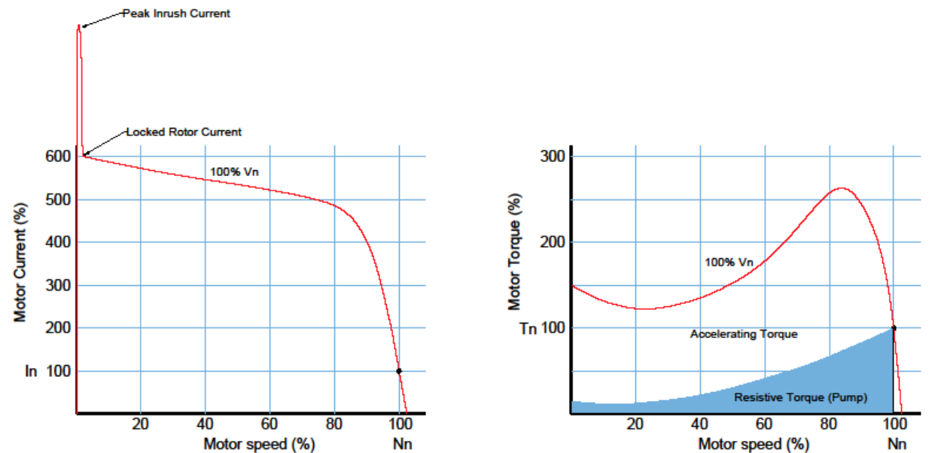
Fire Pump Controllers
Starting Methods: Full Voltage - Across the Line (Direct on Line)

Slide 19
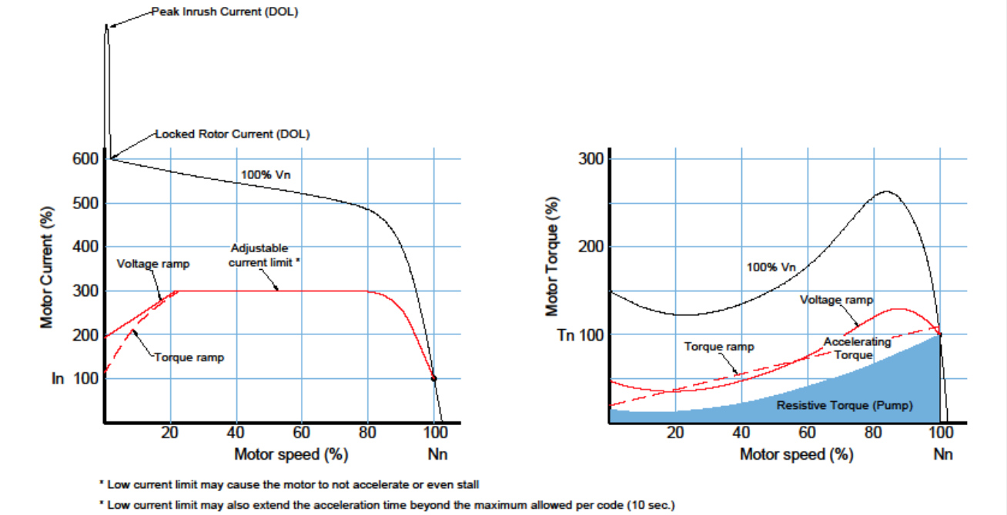
Fire Pump Controllers
Starting Methods: Reduced Voltage – Electronic Soft Starter
(Soft Start / Soft Stop)

Slide 20
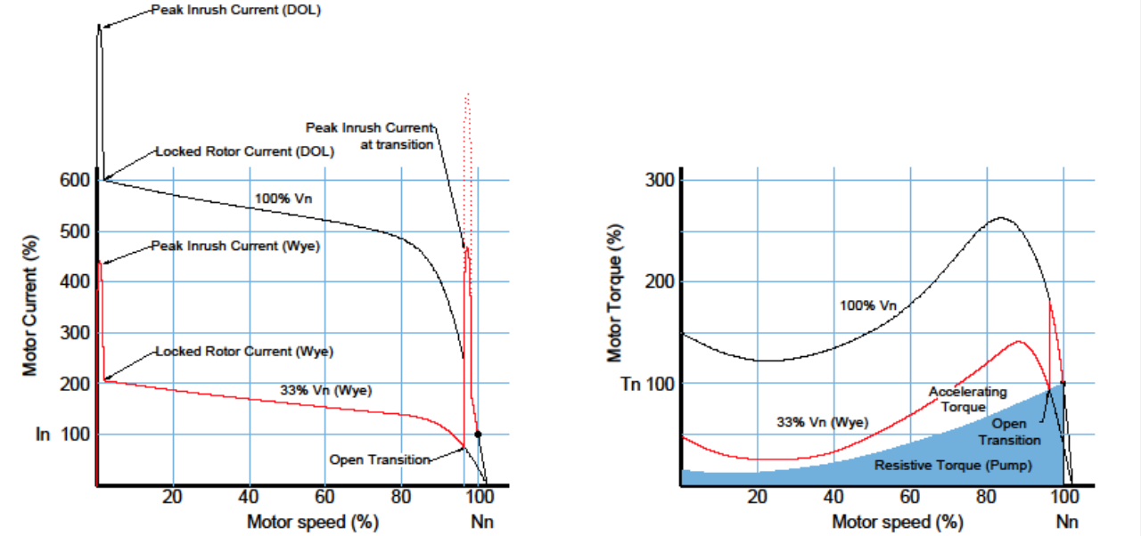
Fire Pump Controllers
Starting Methods: Reduced Voltage – Wye Delta Open

Slide 21
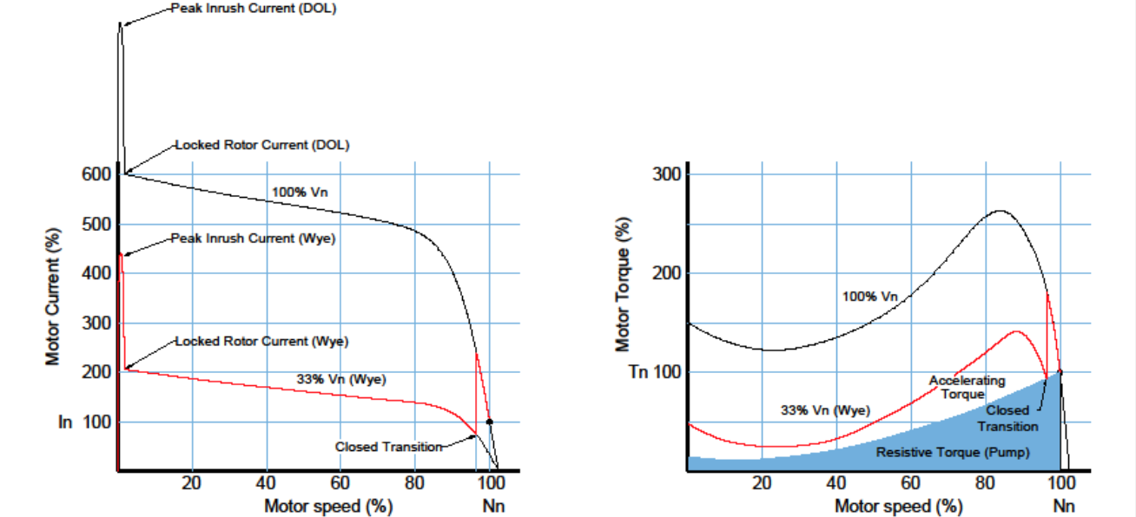
Fire Pump Controllers
Starting Methods: Reduced Voltage – Wye Delta Closed

Slide 22
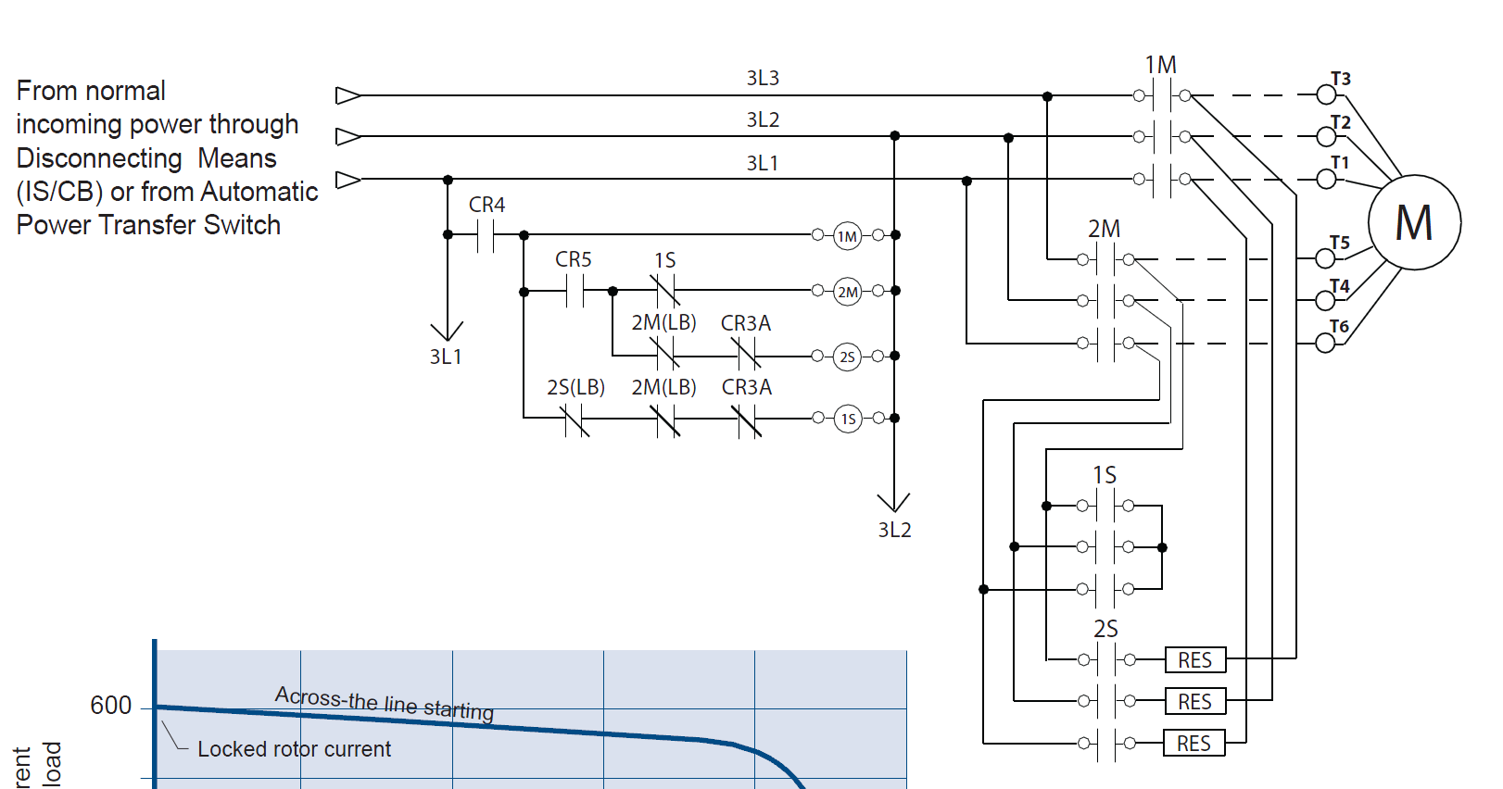
Fire Pump Controllers
Starting Methods: Reduced Voltage – Wye Delta Closed
Starting Method: Reduced Voltage - Wye-delta closed
Typical Voltage Applied at Start: 100%
Inrush Current: 33% of normal load current
Starting Torque: 33%
Motor Type: Wye-delta
No. of Contactors: 2 at 58%, 1 at 33% of motor full load current (FLC)
Min. ampacity of motor conductors: 6 at 125% x 58% of FLC

Slide 23
VFD - Benefits
A Variable Speed Controller will:
  Eliminate water surge and hammer in the piping on pump start up
  Reduce current surge on start up of fire pump and reduce generator set sizing
  Save money on installations and maintenance where high pressure piping and fittings are required to handle pump overpressure
  (Can) eliminate the need for floor-by-floor Pressure Control
  (Can) eliminate “Break Tanks” on systems with fluctuating supply pressures
  Save water during weekly testing without draining from the main relief valve
  (Can) increase the number of floors serviced by the fire pump without Pressure Reducing Valves (PRV)
  Be ideally suited for ESFR systems, large campuses, hospital applications, high rise and retrofit for code upgrade purposes

Slide 24
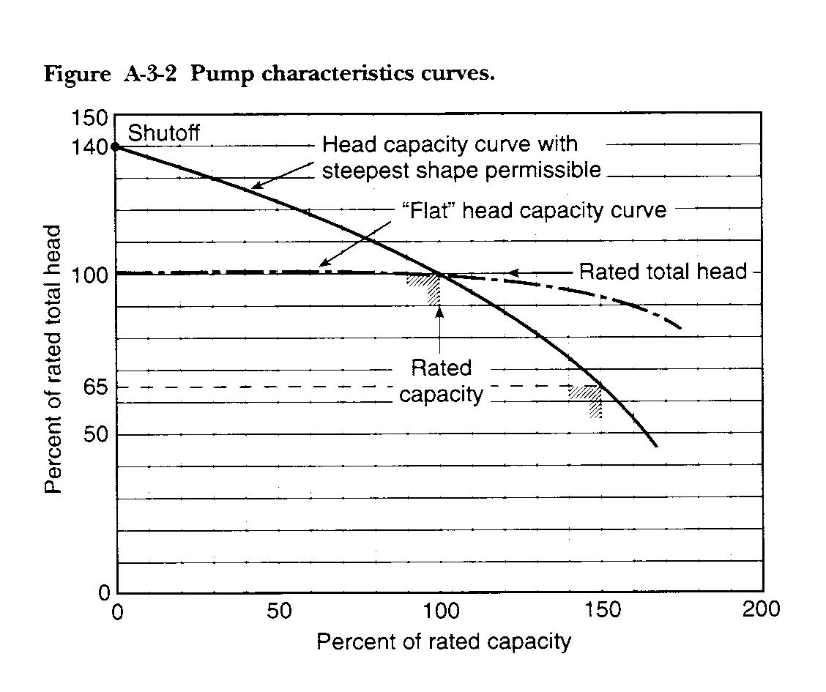
Shut Off Pressure – Eliminated
Pump shut-off
Pump
Over-pressure
VPx Pump Pressure
Back

Slide 25
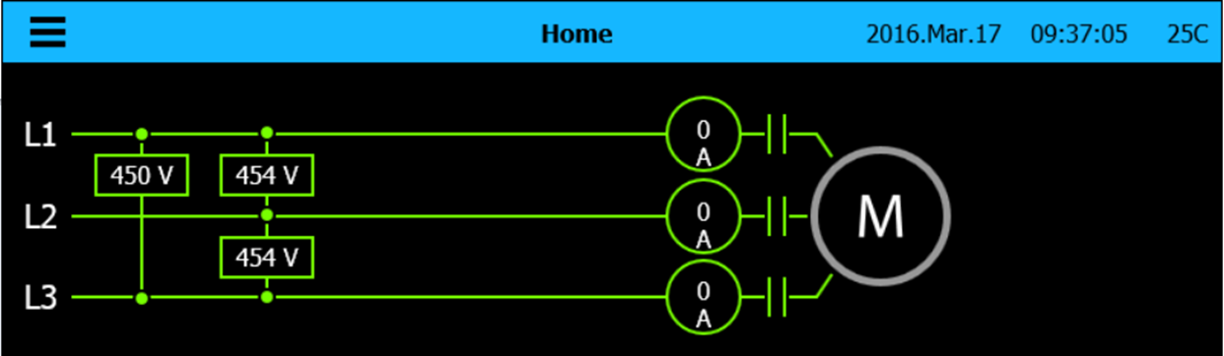
Fire Pump Controllers 101
Electric Fire Pump Controllers
Full Service
  Voltmeter mounted on door front
  Ammeter mounted on door front

Slide 26
Fire Pump Controllers 101
Electric Fire Pump Controllers
Full Service
  Short Circuit Withstand Rating
    Industry standard: 100,000A
    Optional ratings available
  Across-the-line or reduced voltage start

Slide 27
Fire Pump Controllers 101
Electric Fire Pump Controllers
Full Service
  Locked rotor protection
    6 x motor full load amperage (FLA, FLC)
    Factory set and calibrated to trip (open) between 8 and 20 seconds
  Emergency start mechanism
    Across the line start even if starting method is reduced voltage

Slide 28
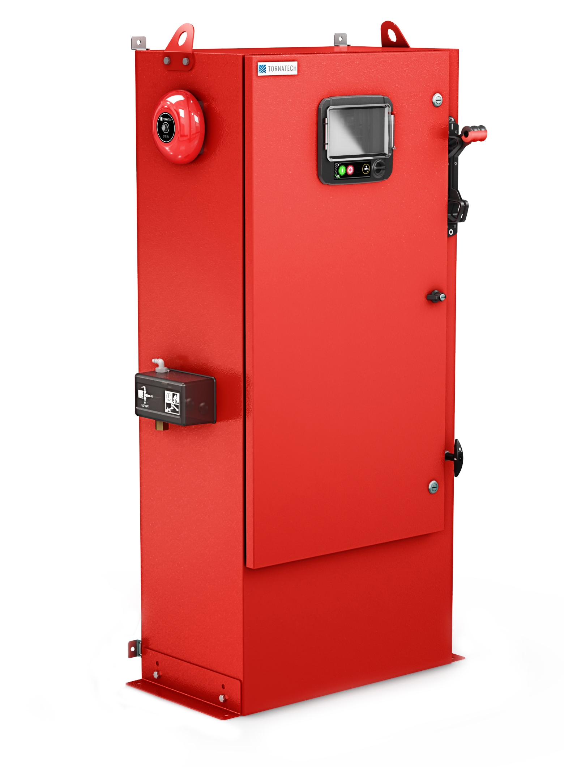
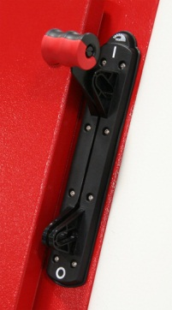
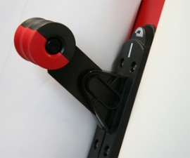
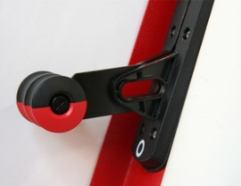
Fire Pump Controllers 101
Electric Fire Pump Controllers
Full Service
Single operator for ON-OFF

Slide 29
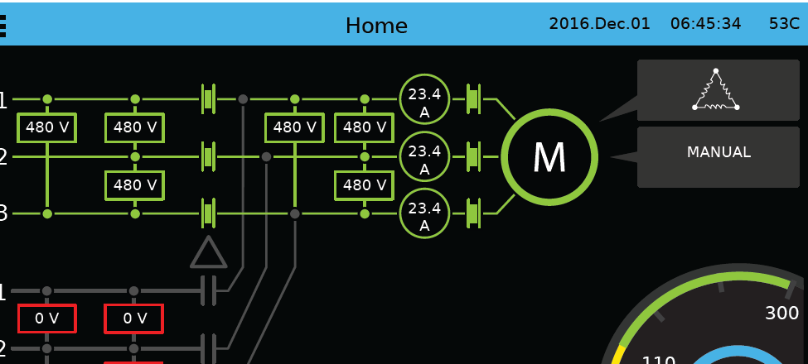
Fire Pump Controllers 101
Electric Fire Pump Controllers
Full Service
  Visual indications
    Power Available
    Motor RUN
    Phase Reversal

Slide 30
Fire Pump Controllers 101
Electric Fire Pump Controllers
Full Service
Visual indications
  Automatic or non-automatic
  Type of Actuation
    Pressure or non-pressure
  Type of Shutdown
    Manual or automatic

Slide 31
Fire Pump Controllers 101
Electric Fire Pump Controllers
Full Service
Contacts for remote alarm annunciation
  Power Available
  Motor RUN
  Phase Reversal

Slide 32
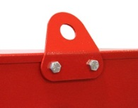
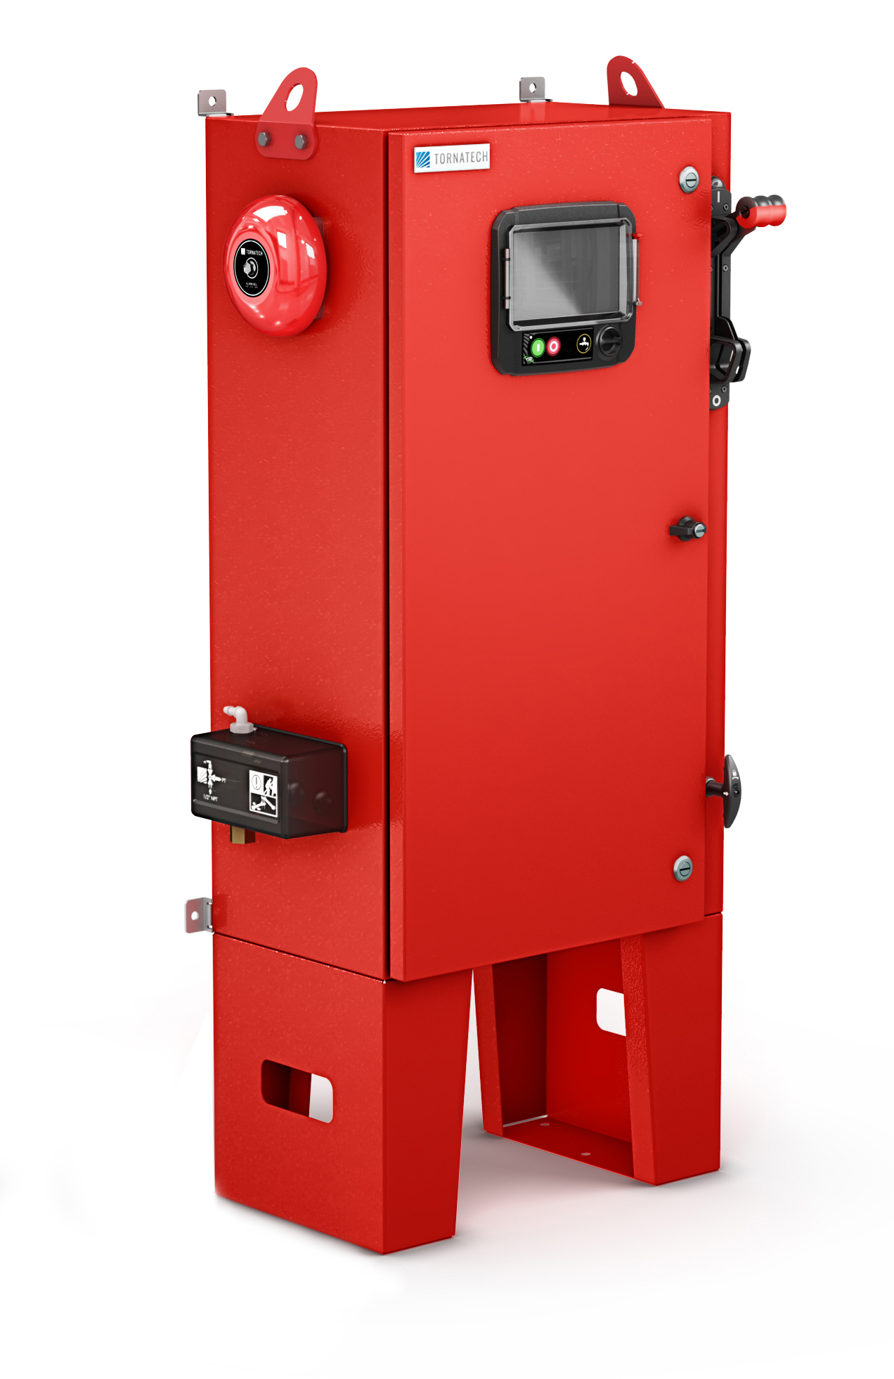
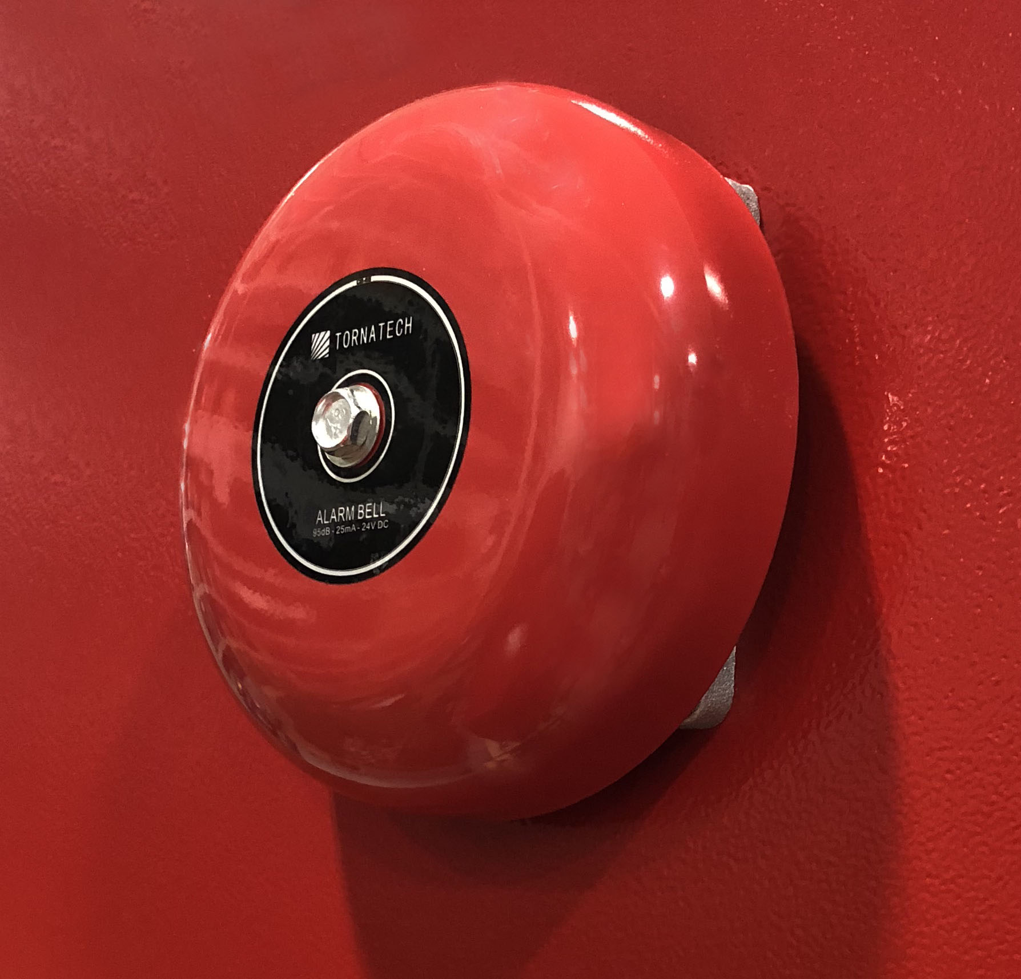
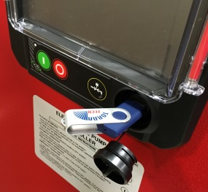
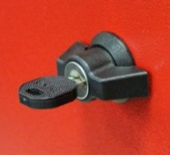
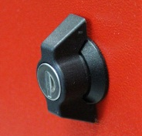
Fire Pump Controllers 101
Electric Fire Pump Controllers
Lifting Lugs
4” Alarm Bell
Custom designed IS/CB operator handle
ViZiTouch V2 Operator Interface
Externally mounted pressure transducer and run test solenoid valve with protective cover.
Key lock
Exterior and Interior USB Port

Slide 33
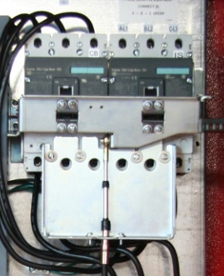

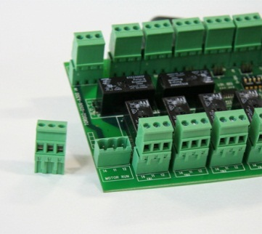

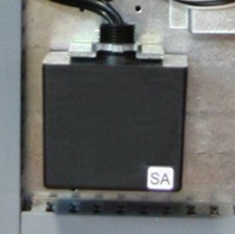
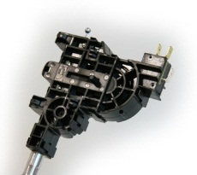
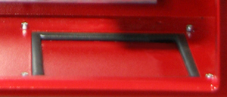
Fire Pump Controllers 101
Electric Fire Pump Controllers
Circuit Breaker & Isolating switch assembly
I/O board with removable alarm contact terminals
Motor Contactor
Surge arrestor
Custom designed emergency start mechanism with integrated limit switch
Model GPA

Slide 34
Fire Pump Controllers 101
Automatic Power Transfer Switch
Full Service
  Automatic Power Transfer Switch
    Required if normal utility power is not reliable
    Housed in a barriered compartment or in a separate enclosure attached to the fire pump controller

Slide 35

Fire Pump Controllers 101
Automatic Power Transfer Switch
Full Service
  Automatic Power Transfer Switch
    Listed and Approved for fire pump service
    Transfer switch TEST pushbutton

Slide 36
Fire Pump Controllers 101
Automatic Power Transfer Switch
Full Service
  Contacts for remote alarm annunciation
    Isolating switch in the OFF position
    Transfer switch in normal position
    Transfer switch in alternate (emergency) position

Slide 37
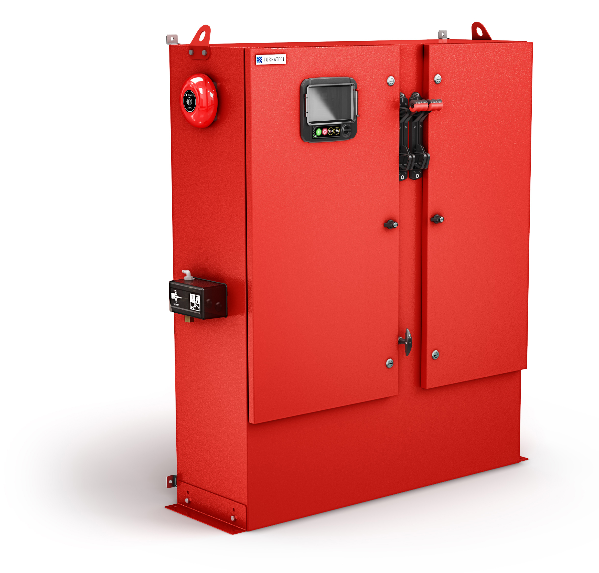
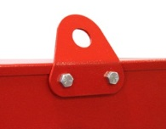
Fire Pump Controllers 101
Automatic Power Transfer Switch
4” Alarm Bell
Lifting Lugs
Custom designed IS/CB operator handle
Externally mounted pressure transducer and run test solenoid valve with protective cover.
ViZiTouch V2 Operator Interface
Exterior and Interior USB Port
Key lock

Slide 38
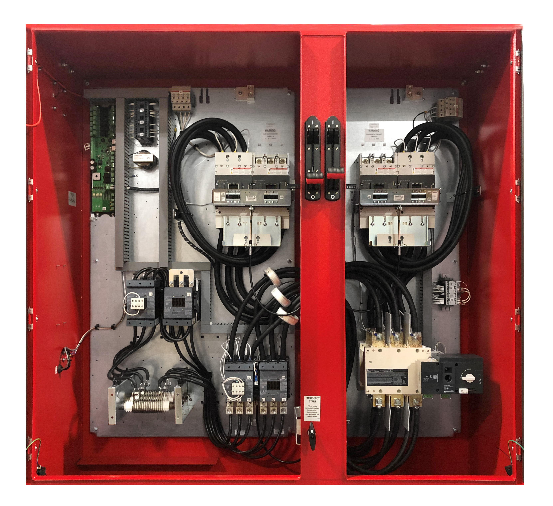

Fire Pump Controllers 101
Automatic Power Transfer Switch
I/O board with removable alarm
contact terminals
Circuit Breaker & Isolating switch assembly
Surge arrestor
Transfer Switch
Gland plate
Model GPU

Slide 39
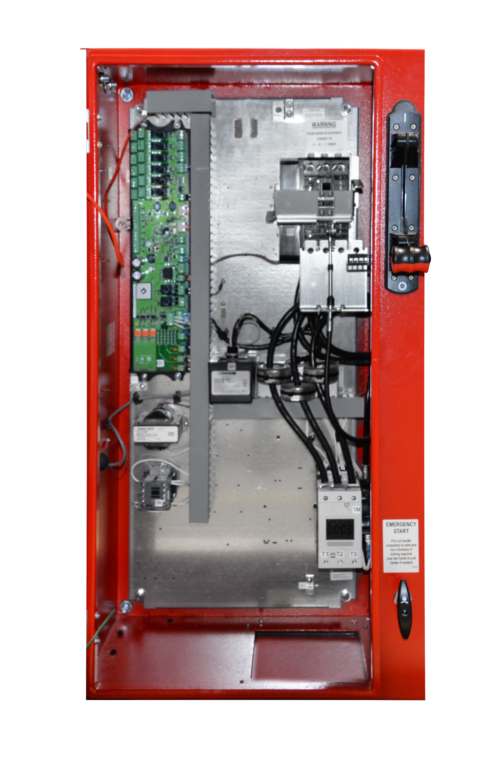
Fire Pump Controllers 101
Electric Fire Pump Controllers
Limited Service
Has all the requirements of a full service fire pump controller except for:
    UL Listed only
    Three phase and single phase power is allowed
    HP rating limited to and including 30hp

Slide 40
Fire Pump Controllers 101
Electric Fire Pump Controllers
Limited Service
  Use (installation) must be approved by AHJ
  Only across-the-line starting is allowed

Slide 41
Fire Pump Controllers 101
Diesel Fire Pump Controllers
Operates off of engine batteries
    12VDC or 24VDC
Single phase power required to power the battery chargers
Individual (two) battery chargers
Monitors the battery status and keeps batteries charged and ready to start engine when required

Slide 42
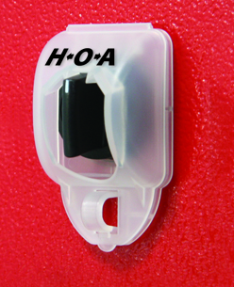
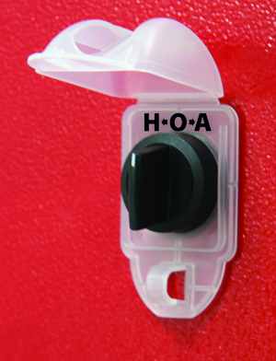
Fire Pump Controllers 101
Diesel Fire Pump Controllers
HAND-OFF-AUTO selector switch behind a lockable but breakable cover
Individual (two) crank pushbuttons
7 – day pressure recorder

Slide 43
Fire Pump Controllers 101
Diesel Fire Pump Controllers
Audible alarm

Slide 44
Fire Pump Controllers 101
Diesel Fire Pump Controllers
Visual indications
  Battery voltage
  Battery amperage
  AC power on
  Main selector switch in automatic position
  Battery 1 and 2 failure
  Engine run
  Charger 1 and 2 failure
  Engine low oil pressure
  Engine high temperature
  Engine overspeed

Slide 45
Fire Pump Controllers 101
Diesel Fire Pump Controllers
Contacts for remote alarm annunciation
  Engine RUN
  Common controller trouble
  Selector switch in OFF or HAND
  Common engine trouble
  Common pump room alarm

Slide 46
Fire Pump Controllers 101
Diesel Fire Pump Controllers
Alarm and shutdown schedule
Alarm and shutdown schedule |  | Automatic Start | Manual Start or Remote Start | Run Test or Periodic Test
 | High Coolant | Alarm only | Alarm only | Shutdown
 | Low Oil Pressure | Alarm only | Alarm only | Shutdown
 | Overspeed | Shutdown | Shutdown | Shutdown

Slide 47
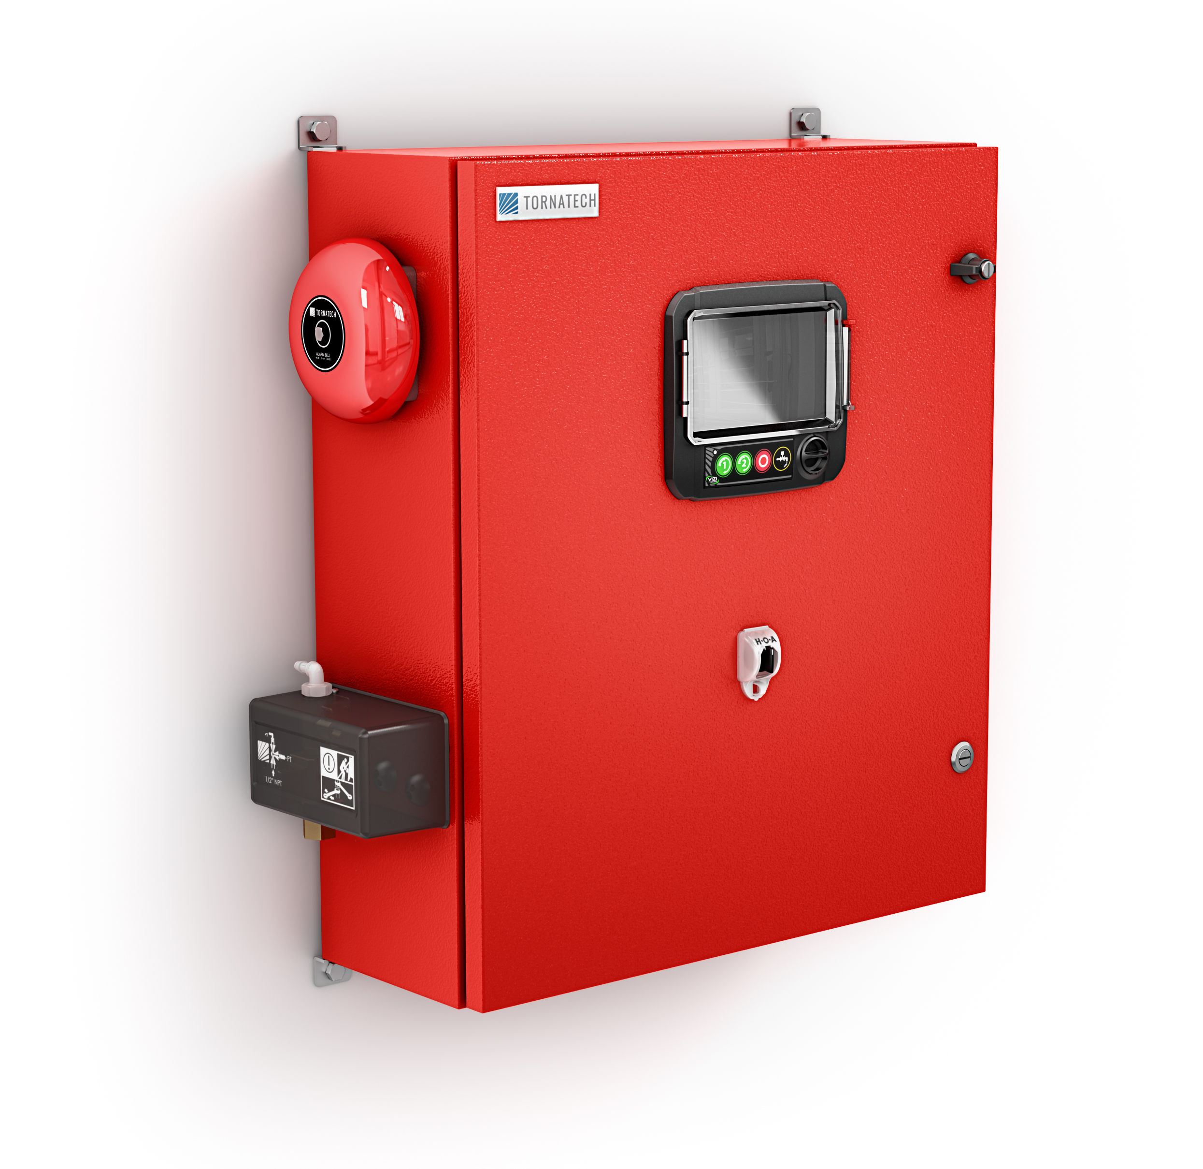
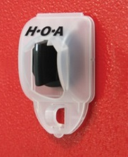
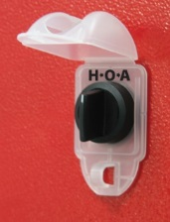
Fire Pump Controllers 101
ViZiTouch V2
Operator Interface
Diesel Fire Pump Controllers
Key Lock
4” Alarm Bell
Externally mounted pressure transducer and run test solenoid valve with protective cover
Exterior USB Port
Hand-Off-Auto selector switch

Slide 48
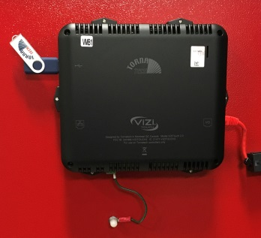
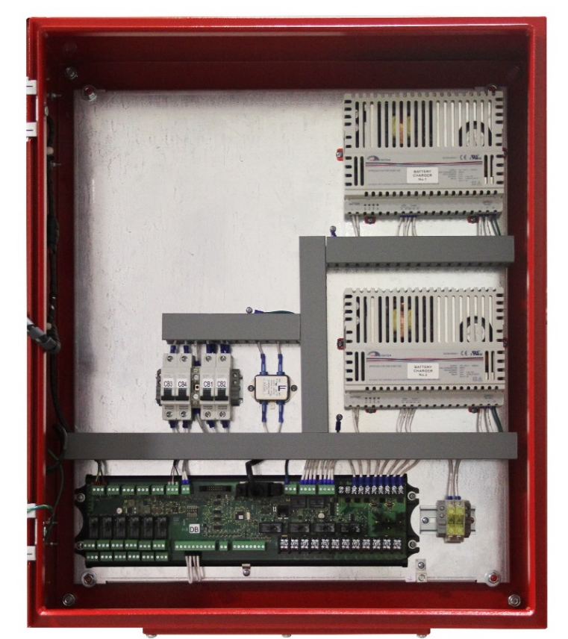
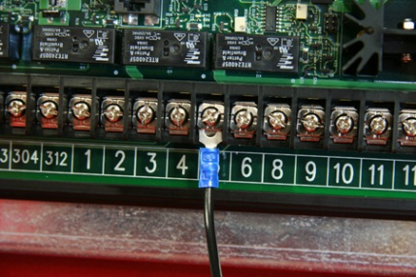
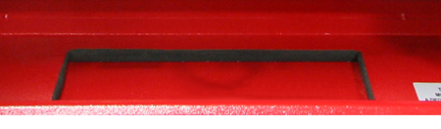
Fire Pump Controllers 101
Diesel Fire Pump Controllers
Interior
USB Port
EMI filter
Battery chargers
AC and DC isolation circuit breakers
Automotive type
engine connections
I/O board with removable alarm contact terminals
Gland plate

Slide 49
Fire Pump Controllers 101
Jockey Pump Controllers
Not considered a “Fire Pump Controller”
Not UL Listed or FM Approved for fire pump service
UL Listed as an Industrial Pump Controller (UL508A)

Slide 50
Fire Pump Controllers 101
Jockey Pump Controllers
Required to start and stop a pressure maintenance pump
(jockey pump) in order to maintain the sprinkler system pressure
Jockey pump shall not be powered by the fire pump controller

Slide 51
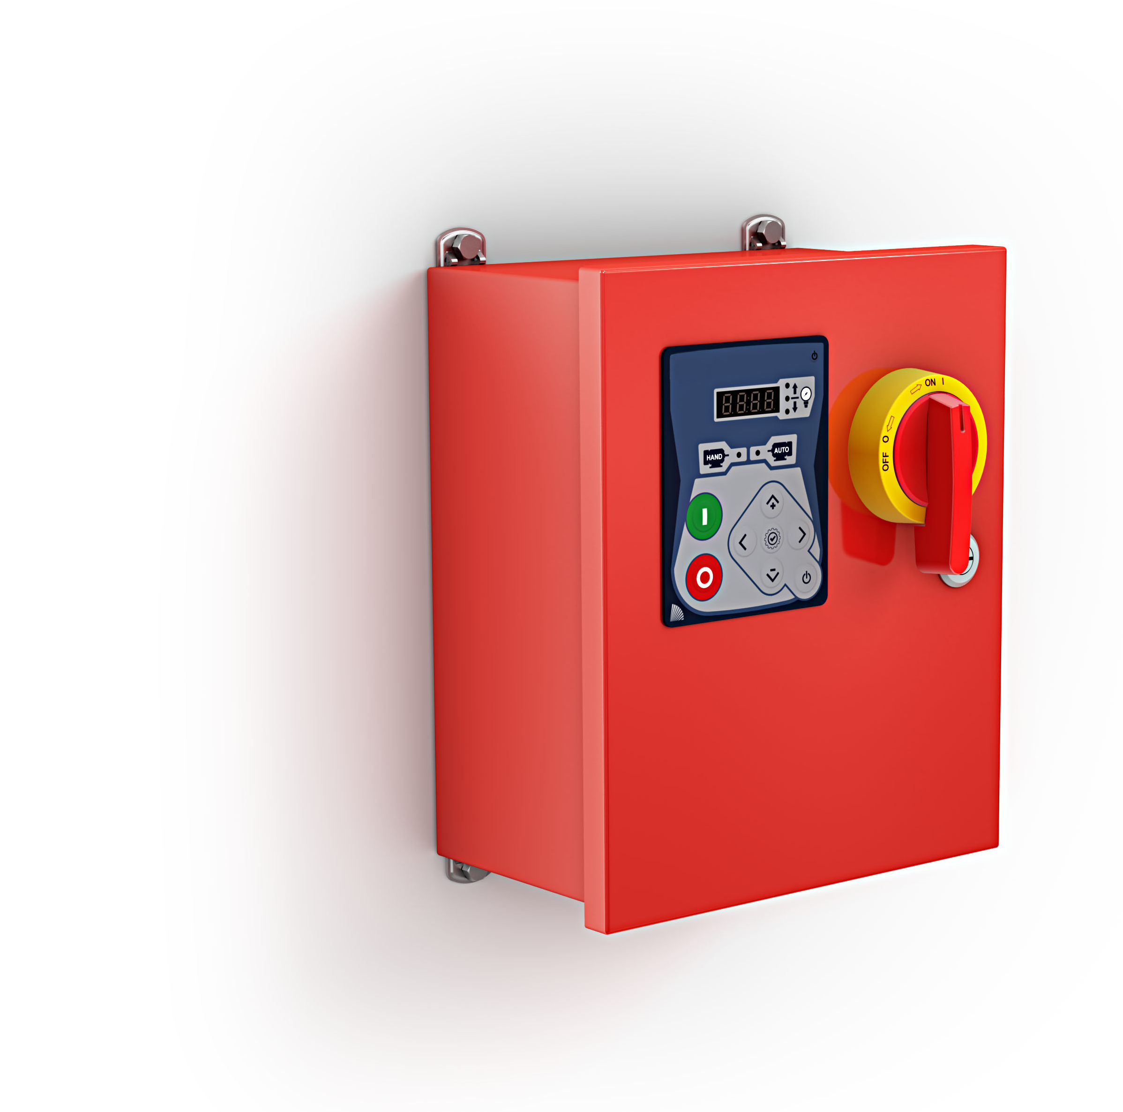
Fire Pump Controllers 101
Jockey Pump Controllers
Wall Mounting Lugs (4)
2 top – 2 bottom
Digital Display
Main Disconnect
iPD+ Operator Interface
Type 2 Enclosure

Slide 52
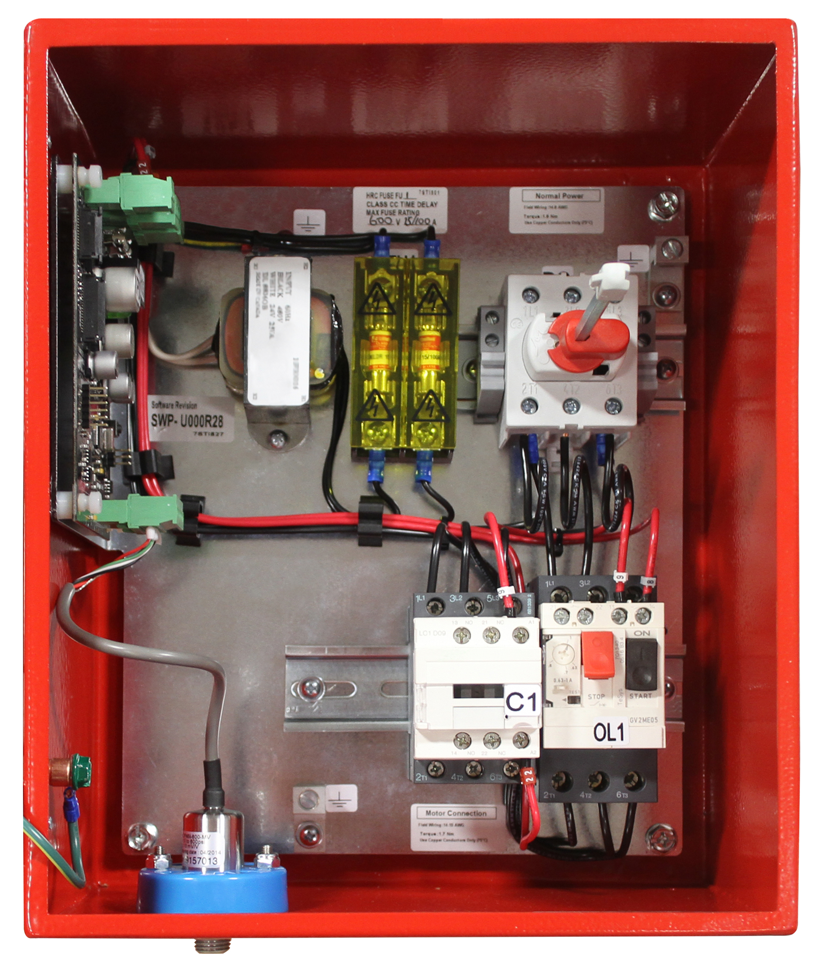
Fire Pump Controllers 101
Jockey Pump Controllers
Horsepower rated door interlocked rotary type disconnect switch
Fuseless magnetic motor starter with thermo-magnetic motor protector and horsepower rated contactor
Pressure transducer with 0-600psi range and stainless
steel construction

Slide 53
Model OPD UL Listed Disconnecting Device
Preface – USA Installations
The installation of a disconnecting means ahead of an electric fire pump controller has always been permitted by NFPA20 and NFPA70 (NEC)
The method of sizing/selecting the disconnecting means device has been for it to hold locked rotor current (6 x FLA) indefinitely (continuously)
In the NFPA20 2013 edition and the NFPA70 2014 edition changes were made to the articles in question

Slide 54
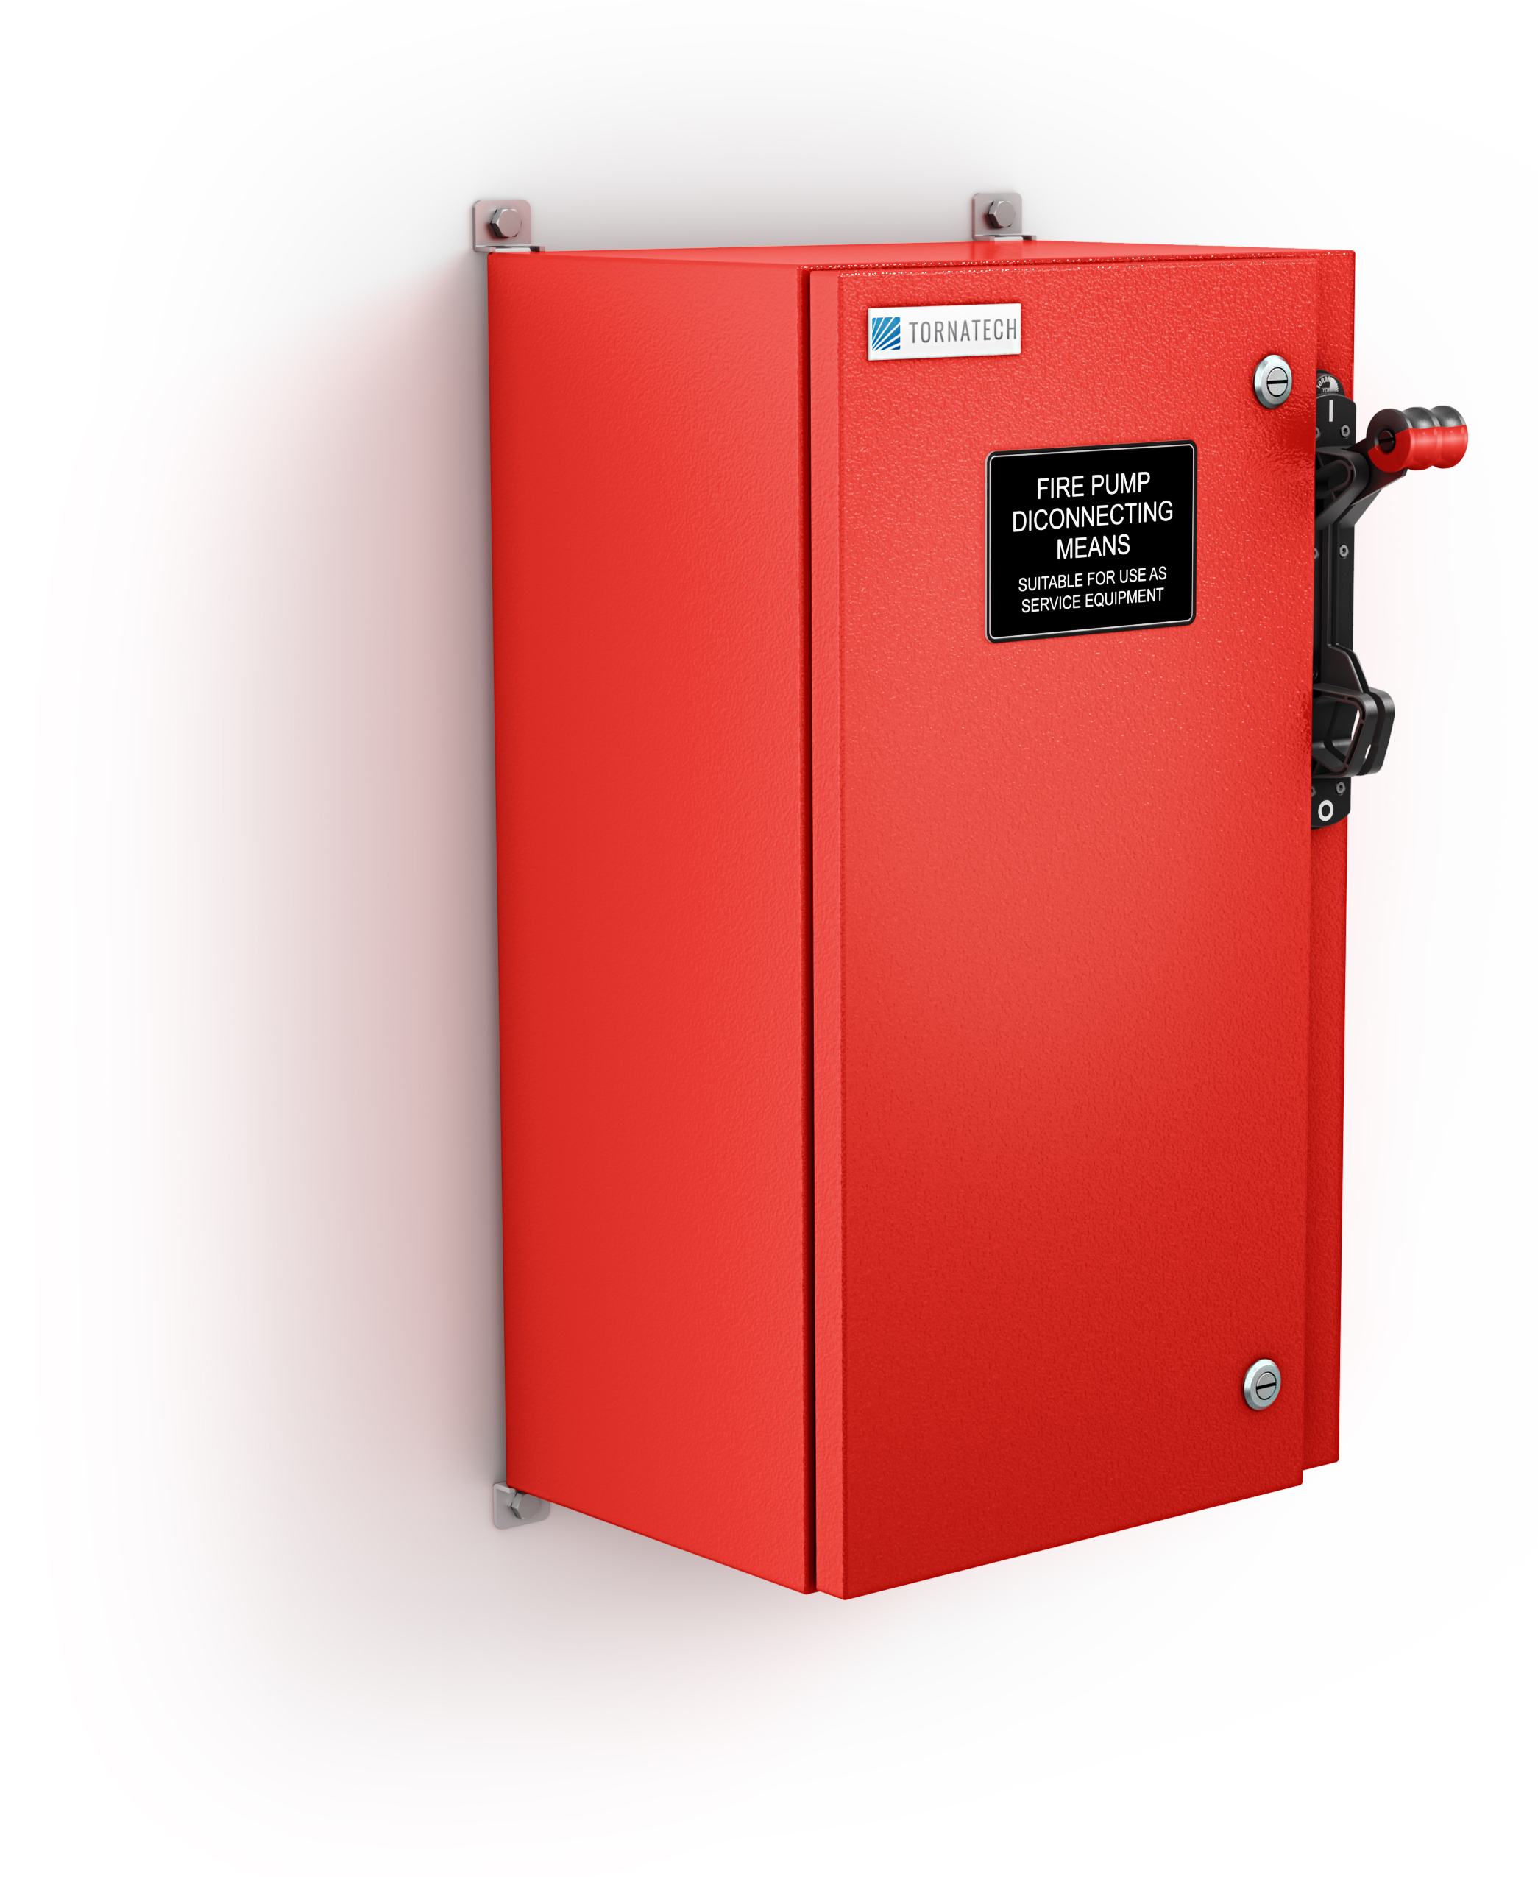
Model OPD UL Listed Disconnecting Device
Standard Features
Suitable as service entrance equipment
NEMA Type 2 enclosure
Disconnect markings as per
NFPA70 (NEC) 695.4(B)(3)(c)

Slide 55
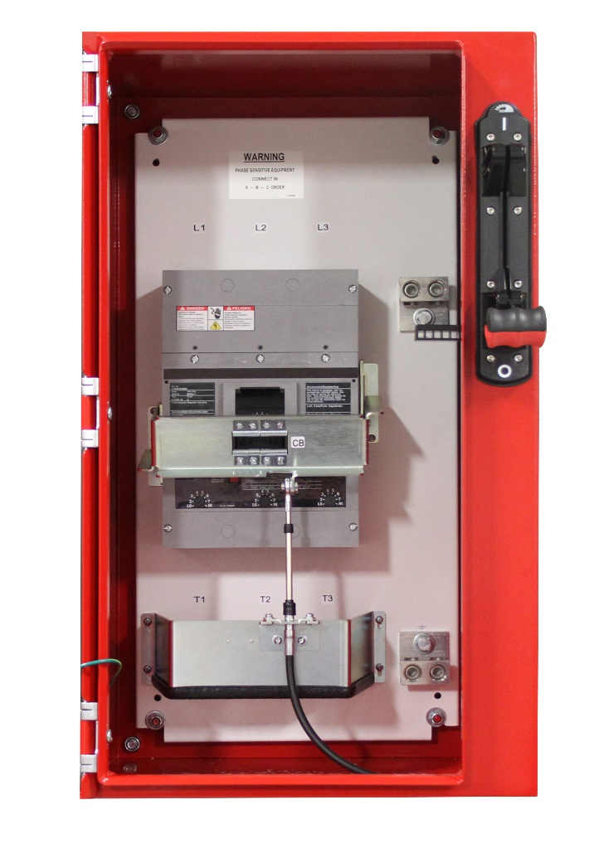
Model OPD UL Listed Disconnecting Device
Standard Features
Overcurrent protection device
Flange mounted disconnect handle lockable in the ON (closed) position as per NFPA70 (NEC) 695.4(B)(3)(a)(2)
Grounding lug

Slide 56
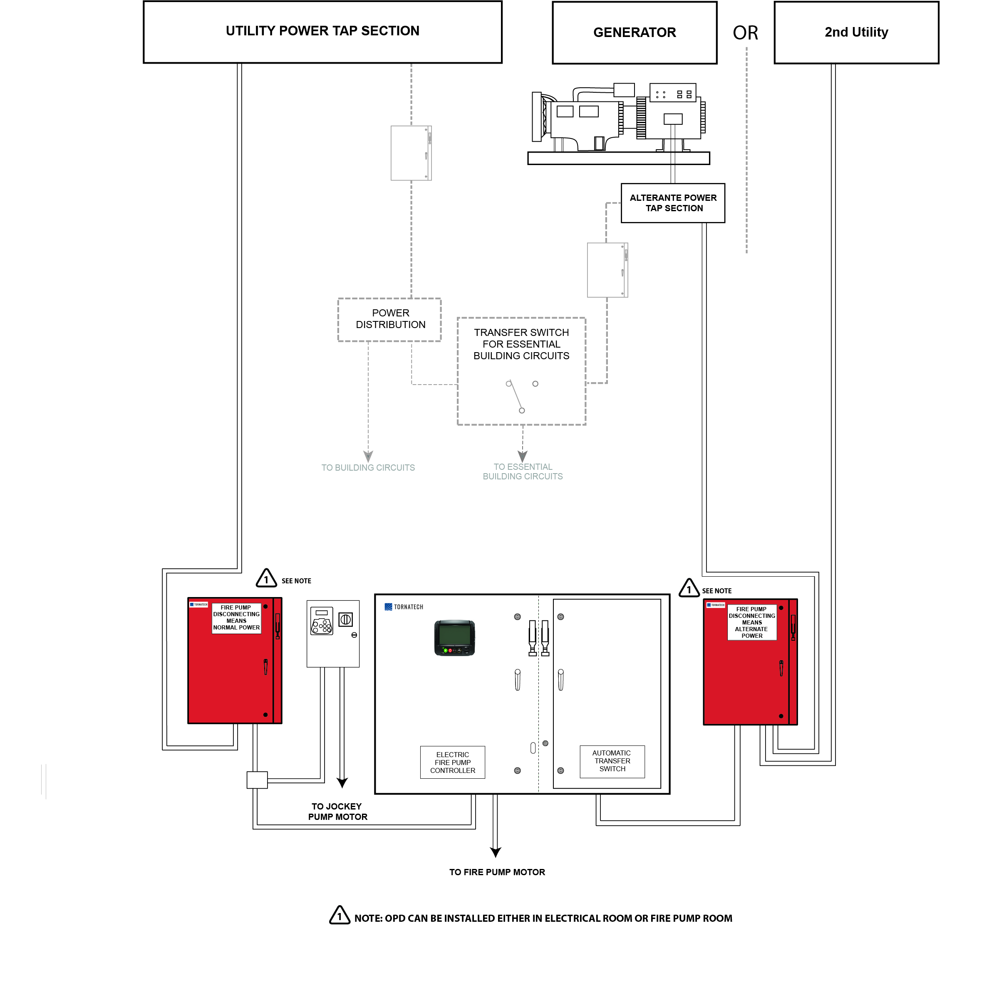
Model OPD UL Listed Disconnecting Device
Typical Installation Schematic

Slide 57
Thank you!
Tornatech Inc. (Head Office)
Laval, Quebec, Canada
Tel: +1 514 334 0523
Toll Free: +1 800 363 8448
Tornatech Europe SPRL
Wavre, Belgium
Tel: +32 (0) 10 84 40 01
Tornatech FZE
Dubai, United Arab Emirates
Tel: +971 (0)4 887 0615
Tornatech Pte Ltd
Singapore
Tel: +65 6795 7823

